Slide 1
E-Commerce Business
Frameworks & Mule soft Solutions

Slide 2
Top 5 e-commerce open source frameworks
Magento (Community Edition)
WooCommerce
OpenCart
PrestaShop
Bagisto

Slide 3
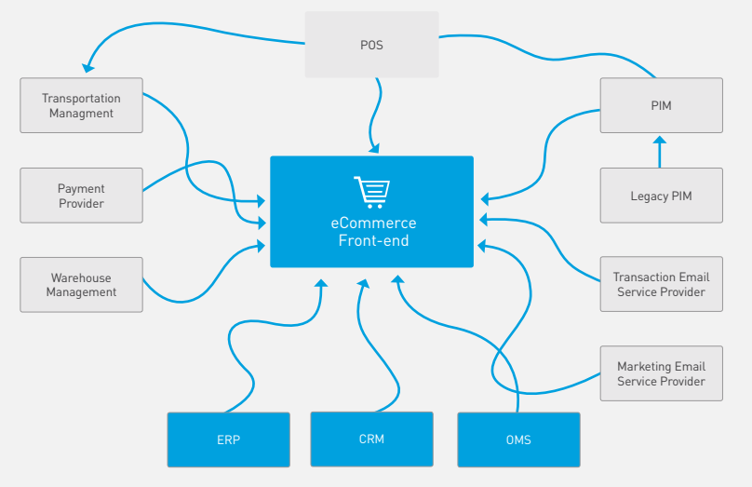
E- Commerce Integrations
When we are dealing with the E- commerce business following are some integrations that are involved

Slide 4
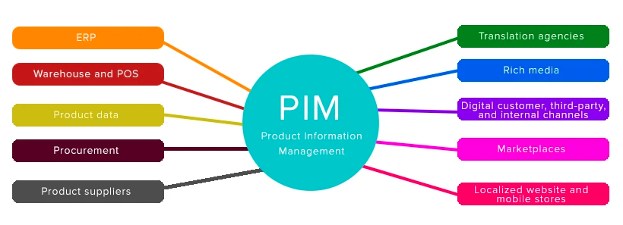
PIM Integration
PIM (Product Information Management), Here are some of the system that uses the PIM data.
To load the PIM data to the multiple system we can select the right integration pattern based on the usage.

Slide 5
OMS Integration
OMS (Order Management System) which involves the following operation in business.
1. Orders created from the Frontend has to be sent to the OMS, we call it as Order Imports.
2. Once Order reached to OMS, sending the Acknowledgements to frontend Systems.
3. Sales Order (SO) generation by OMS.
4. Sending sales Orders to WMS to check the availability.
5. Get the product availability from WMS.
6. Send the Order Confirmations details to Customers/ Frontend systems.
7. Sending the Order Picking status from WMS to OMS.
8. Sending Order Shipping status to OMS and Frontend Systems.
9. Send Shipment confirmation details to WMS.
10. Order Cancellations
11. RMA(Return Merchandise Authorization) creations, sending to the frontend systems and WMS to adjust the price and qty
12. Credit Memo generation.

Slide 6
Market places Integrations
Marketplaces have entirely changed the face of eCommerce. Almost all people start their product searches and make purchases on marketplaces. For retailers marketplaces are great additional sales channel to present their products to millions of customers.
Eg: Amazon, Flipcart, ebay, etc.,

Slide 7
Store pickup/ Customer pick up Integrations
Customers can go inside the store to a designated online pickup area where a store associate will hand over the items. Some stores are taking it one step further by facilitating curb-side pickup – where a customer can drive up to the store location and receive their order without ever leaving the car.

Slide 8
Magento key features
Analytics and Reporting - the script is integrated with Google Analytics and offers many different reports.
Product Browsing - multiple images for products, options for extensive reviews, wishlists and much more.
Catalog Browsing - easy navigation, advanced product filtering system, product comparison.
Catalog Management - inventory management, batch import and export of products, different tax rates per location, additional product attributes.
Customer Accounts - order status and history, e-mail and RSS feeds for products in the wishlist, newsletter subscription, default billing and shipping address.
Customer Service - enhanced features for customers' accounts, Contact Us form, comprehensive order tracking and history, customizable order e-mails.
Order Management - create orders through admin area, create multiple invoices shipments and credit memos, call center order creation option.
Payment - different payment methods: credit cards, PayPal, Authorize.net, Google Checkout, checks, money orders, support of external payment modules like Cybersource, ePay, eWAY and many more.
Shipping - shipping to multiple addresses, flat rating shipping, supports UPS, UPS XML (account rates), FedEx (account rates), USPS and DHL.
Checkout - one page checkout, SSL support, checkout without having an account.
Search Engine Optimization - 100% Search Engine Friendly, Google SiteMap support.
International Support - multiple languages and currencies, list of allowed countries for registration, purchasing and shipping, localization.
Marketing Promotions and Tools - coupons, discounts and different promotion options.
Site Management - control of multiple web sites, multiple languages, tax rate with support for US and International markets, customizable outlook through templates.

